Slide 1
COVID-19 Tweet Scanner
Vidhi Parekh, Sourabh Natesh, Visheshank Mishra

Slide 2

Outline
Introduction
Data Visualization
Data Exploration & Analysis
Results
Data Preprocessing
Future Work
Modeling Methodology
Conclusion

Slide 3



Project Introduction
Social media users increasing with time because they depend on social media for informative content
Different websites and media have their own standard on what is allowed
Use of Twitter data to identify public sentiments to investigate the increased fear associated with coronavirus

Slide 4

Objectives
Explore the dataset to get a clear picture of word semantics, label distribution, their correlation, and key terms that define a specific tweet to be negative or positive
Explore the effectiveness of machine learning approaches beginning with the various models before moving on to deep learning techniques (such as LSTMs and BERT).
Compare the results using data visualization and give possible ways to improve the project or extend the project for future researchers

Slide 5
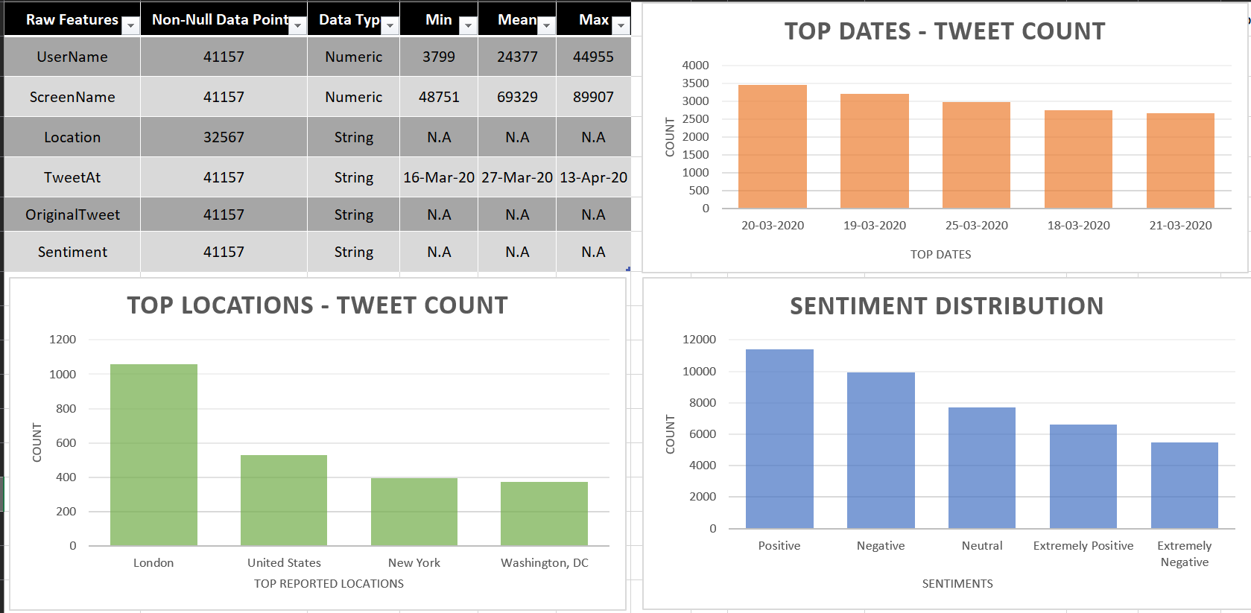
Dataset Description

Slide 6
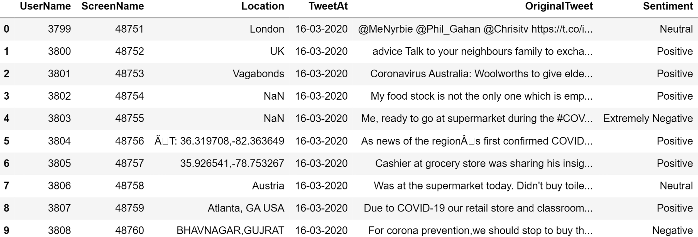
Fig. Sample dataset

Slide 7
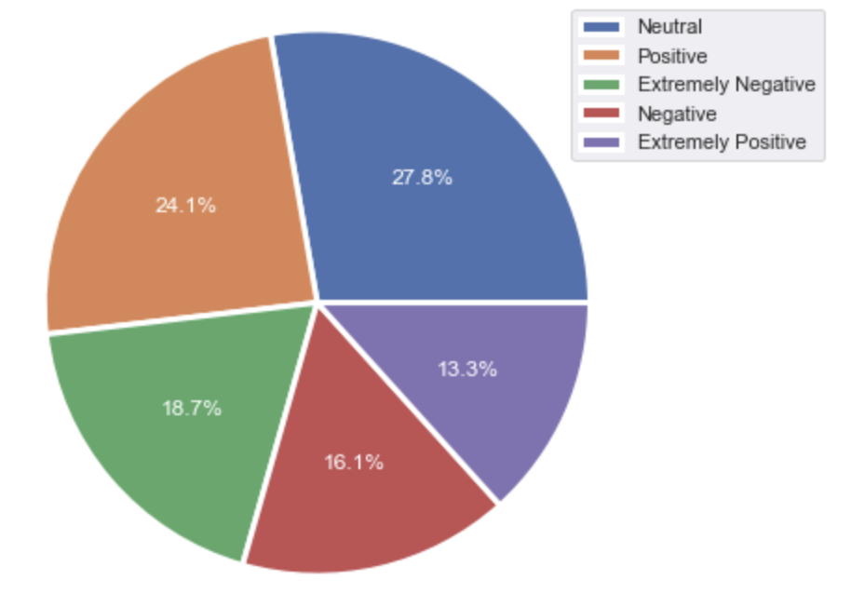
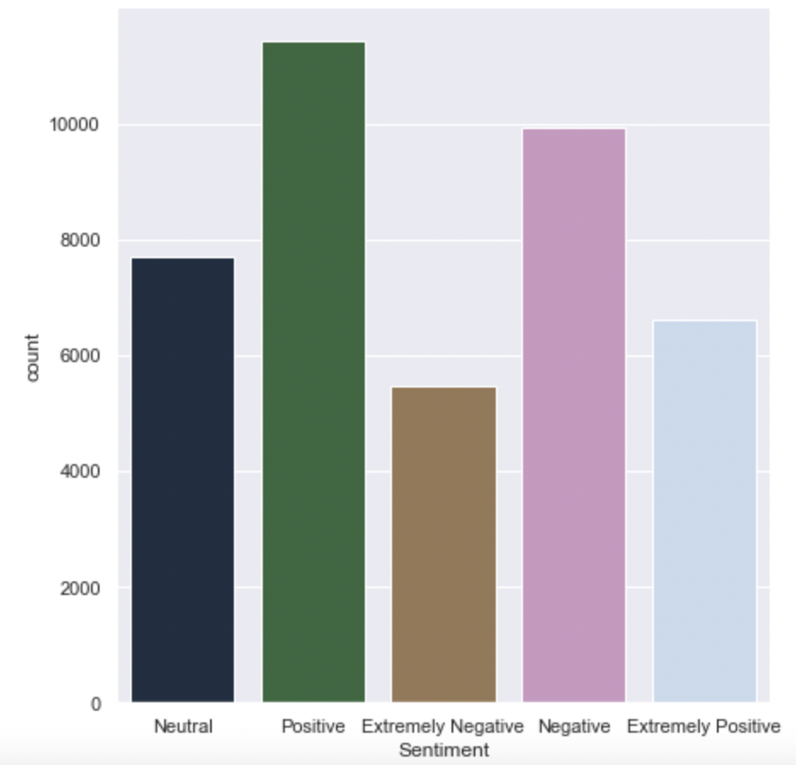
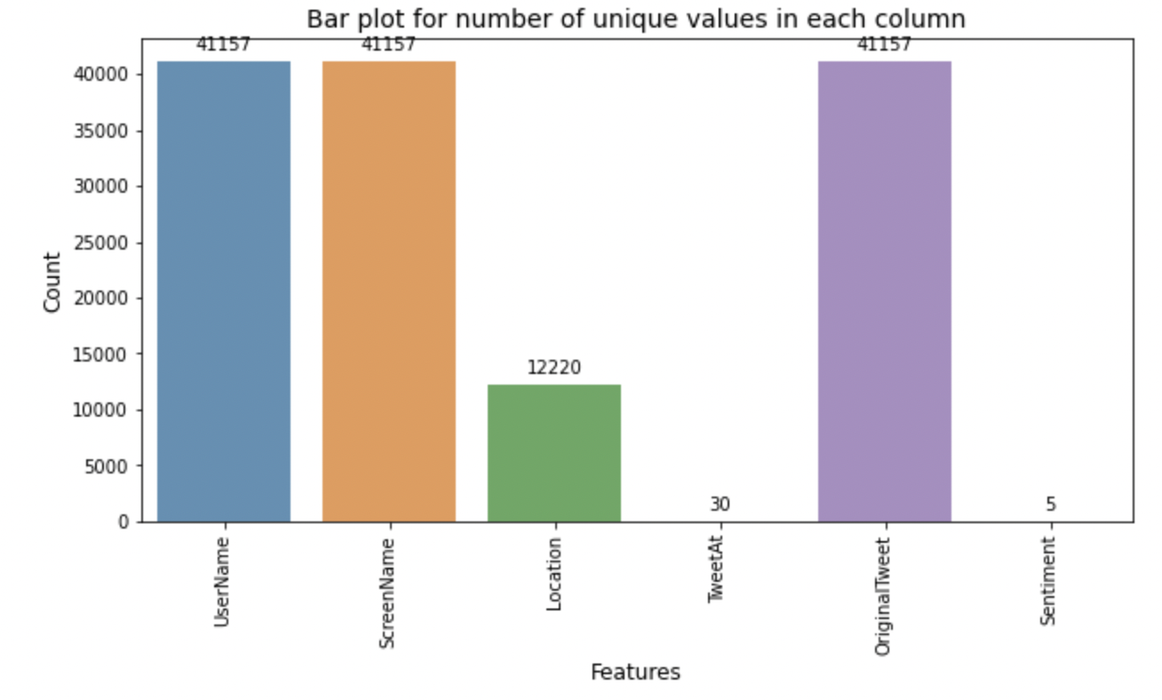
Exploratory Data Analysis
Bar plot for number of unique values in each column
Bar plot containing count of different sentiments

Slide 8
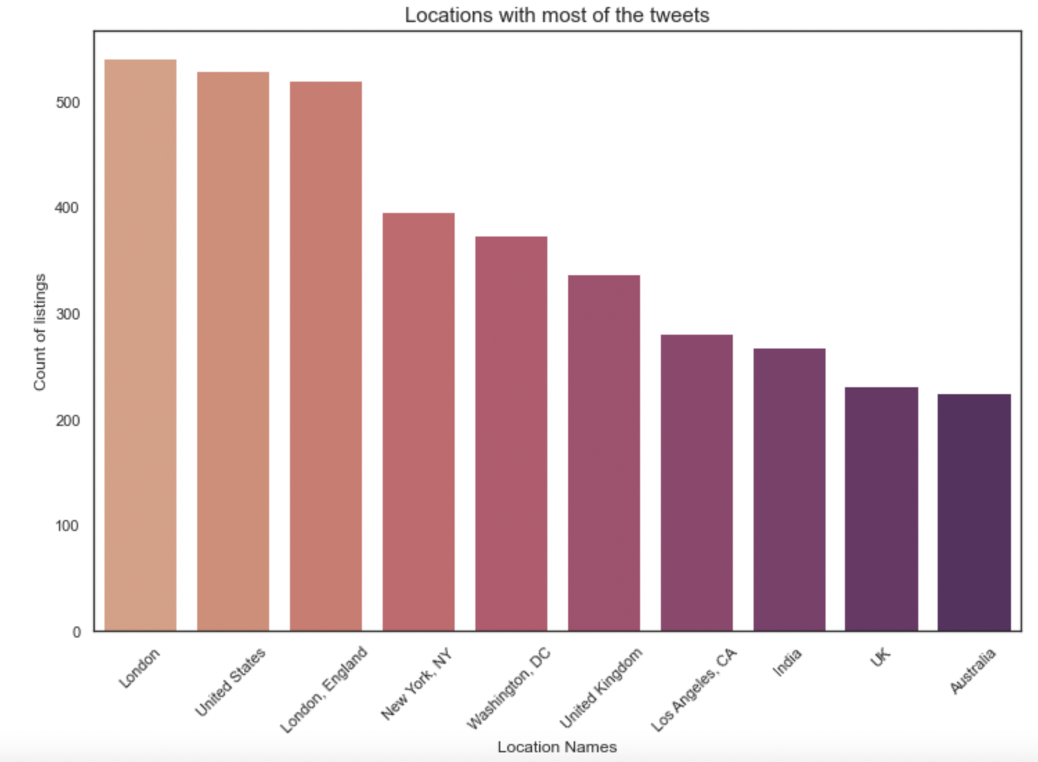
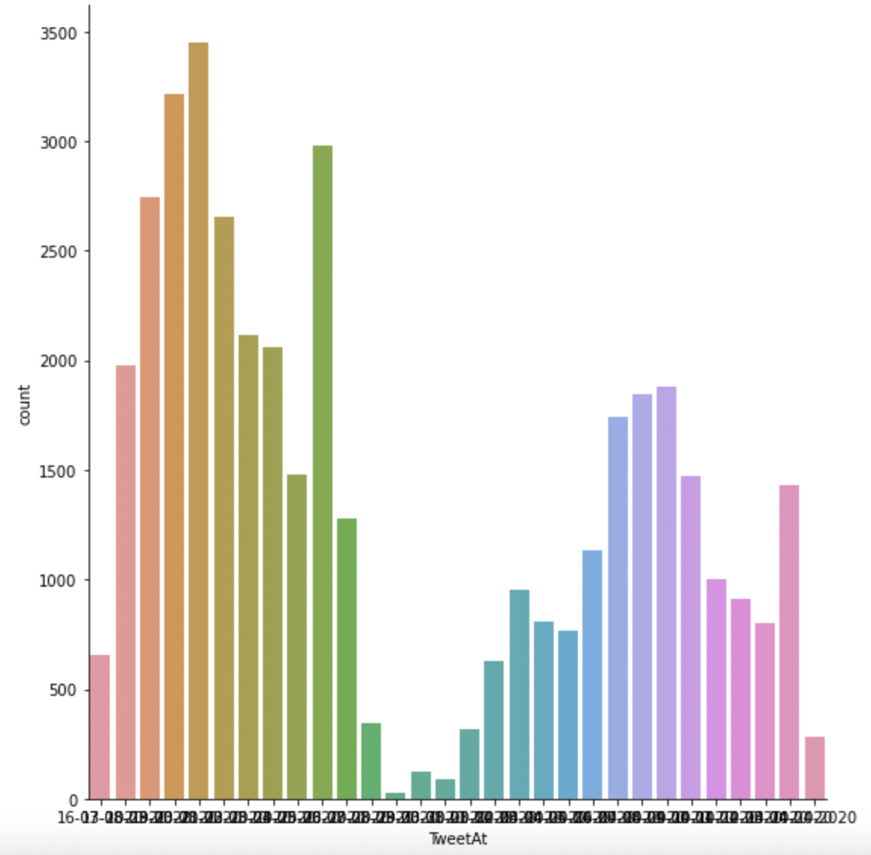
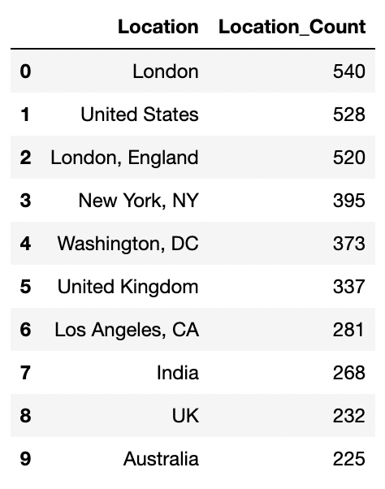
Exploratory Data Analysis
Bar plot containing locations with most tweets
Dataframe representing the top 10 locations where the tweet came from
Graph containing the most frequent locations of tweet

Slide 9
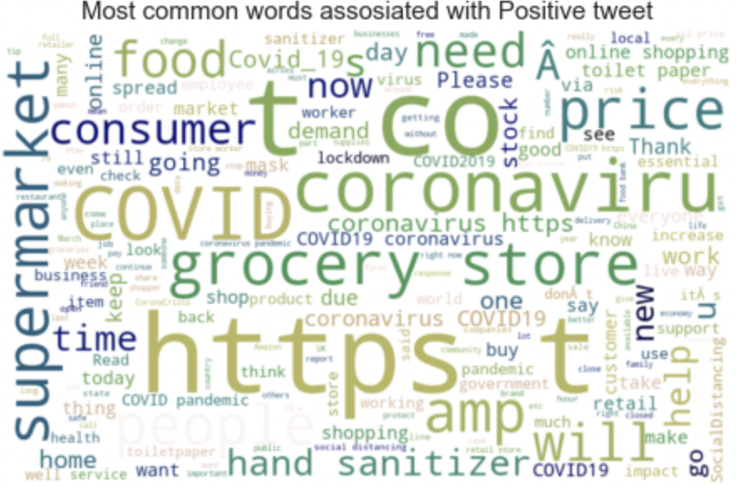
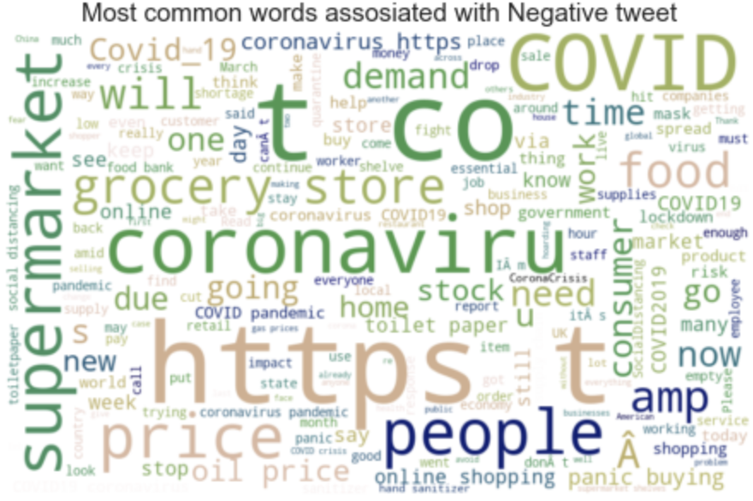
WordCloud
Visual representations of words that give greater prominence to words that appear more frequently.
Helps us to generate and visualize most common words in the entire dataset and also, most common words in the dataset for negative and positive tweets, respectively
In order to get an idea of what are the words that contribute the most to different labels, we developed a function to generate word clouds. The function takes in a parameter label and will produce the word cloud for that sentiment in our dataset.

Slide 10
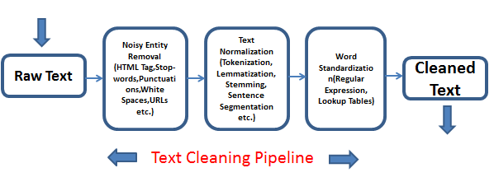
Data Preprocessing
First, we do the basic preprocessing steps such as dealing with missing data and converting categorical variables to numerical variables.
Next, we deal with the text related pre-processing, such as removing stop words, converting to lower-case, removing URLs and tags in the tweet followed by stemming or lemmatization.
We change the labels of extremely negative to negative and extremely positive to positive to avoid misclassification.

Slide 11
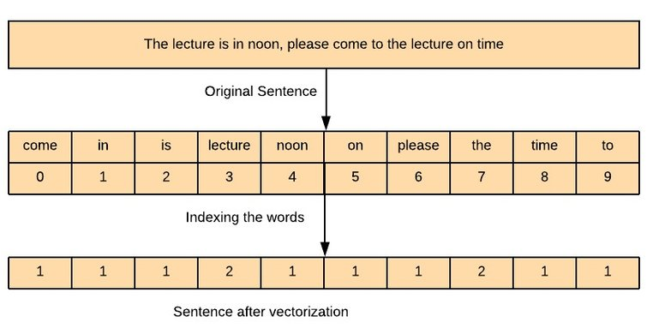
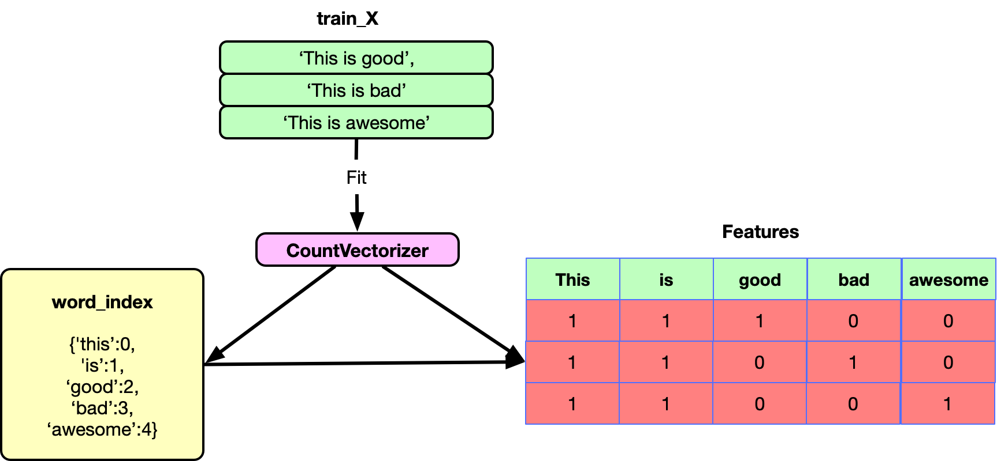
Count Vectorizer
Provided by the scikit-learn library in Python
Transforms a given text into a vector on the basis of the frequency (count) of each word
Representing documents numerically gives us the ability to perform meaningful analytics
In text analysis, vectors are always of a uniform length.
It works better because it gives you access to actual tokens and it avoids hash collisions when the matrix is too small

Slide 12
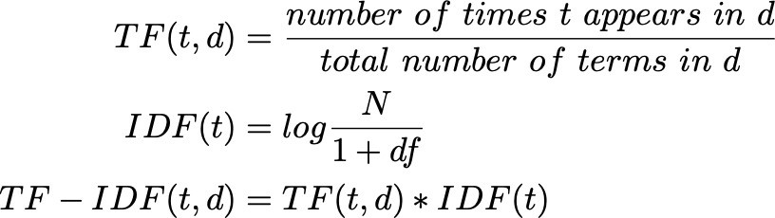
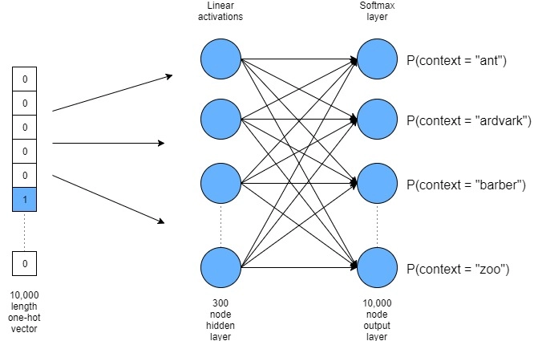
Other Vectorization Techniques
TF-IDF Vectorizer:
Very Similar to the Count Vectorizer except that it uses the TF-IDF scores instead of the raw counts.
Count Vectorizer gives equal importance to all words while TF-IDF penalizes terms which occur very frequently or very rarely.
Word2Vec:
An embedding technique which uses a neural network to generate dense word vectors.
Two types of models - SkipGram and Continuous Bag of Words
Makes use of a sliding window to learn the context words closest to a word.

Slide 13
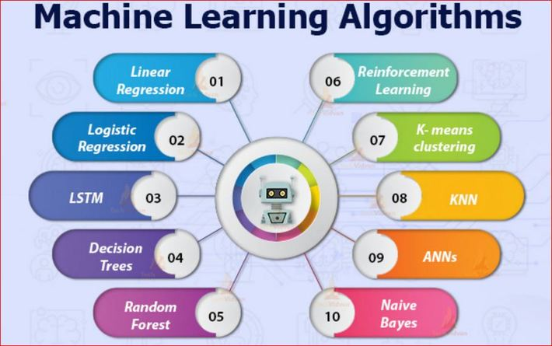
Machine Learning Approach
After we are done with the preprocessing and the vectorization, the next step would be to apply the machine learning techniques to predict the sentiment of the tweets.
We make use of the following models to predict the data:
Naive Bayes (From Scratch)
Logistic Regression (From Scratch)
Support Vector Machine
Random Forest
CatBoost
MLP Classifier

Slide 14
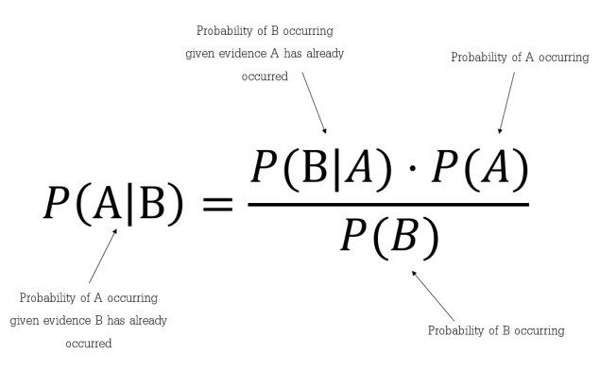
Multinomial Naive Bayes
Simple classification technique that works on the principle of Bayes Theorem.
The theorem makes the “Naive” assumption that the probability of observing a word is an independent event.
We can use this formula to predict the probability of a tweet being positive, negative or neutral.
Naive Bayes is simple, fast model and gives out good results.
The only downfall is that it cannot learn the relationship between words and treats it as Bag of Words model.

Slide 15
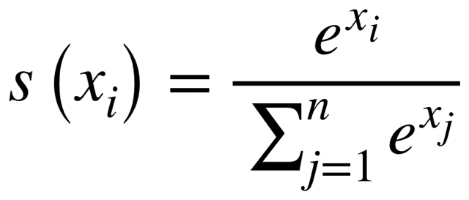
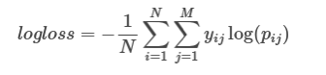
Multinomial Logistic Regression
Logistic Regression is a process of modelling the probability of a discrete outcome given an input variable.
The Softmax function is used to calculate the probabilities of all the classes and then return the class with the highest probability.
Log Loss is used the loss function used. We try to minimize it with the help of gradient descent.

Slide 16
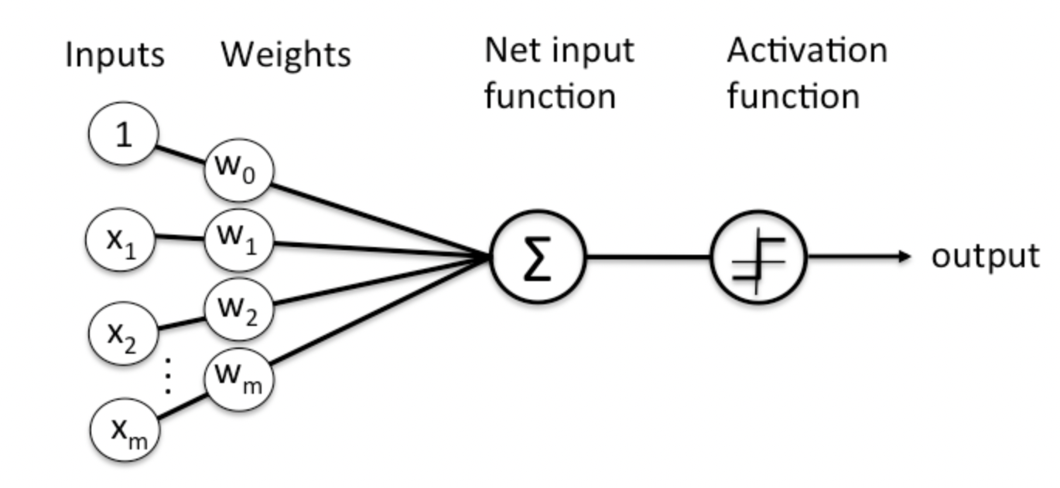
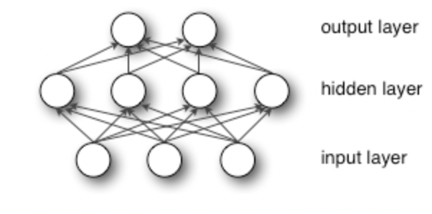
Deep Learning Approach
Neural network model interpret sensory data through a kind of machine perception, labeling or clustering raw input.
Deep-learning networks perform automatic feature extraction without human intervention.
Recurrent neural networks (RNN) feature a context memory layer to incorporate previous state and current inputs, and eventually the output layer for decision making.
Bidirectional LSTM models process information in two directions which allow both backward and forward information.
Layers - 7
Activation functions - softmax, relu
Loss - crossentropy
Optimizer - adam
Metrics - accuracy
Dropout - 0.2
Epochs - 3

Slide 17
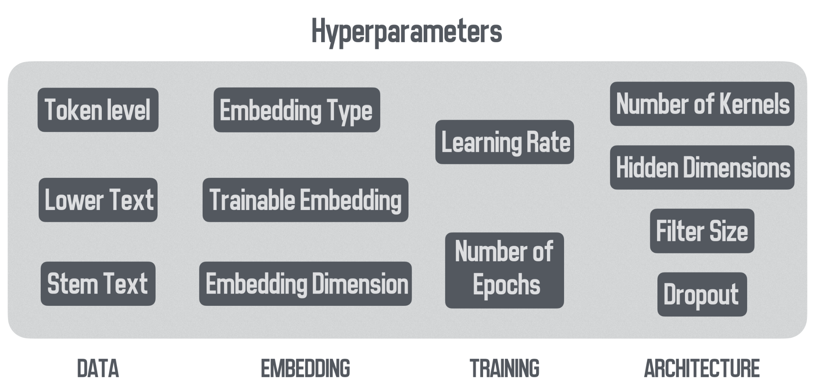
Neural Network Model Architecture

Slide 18
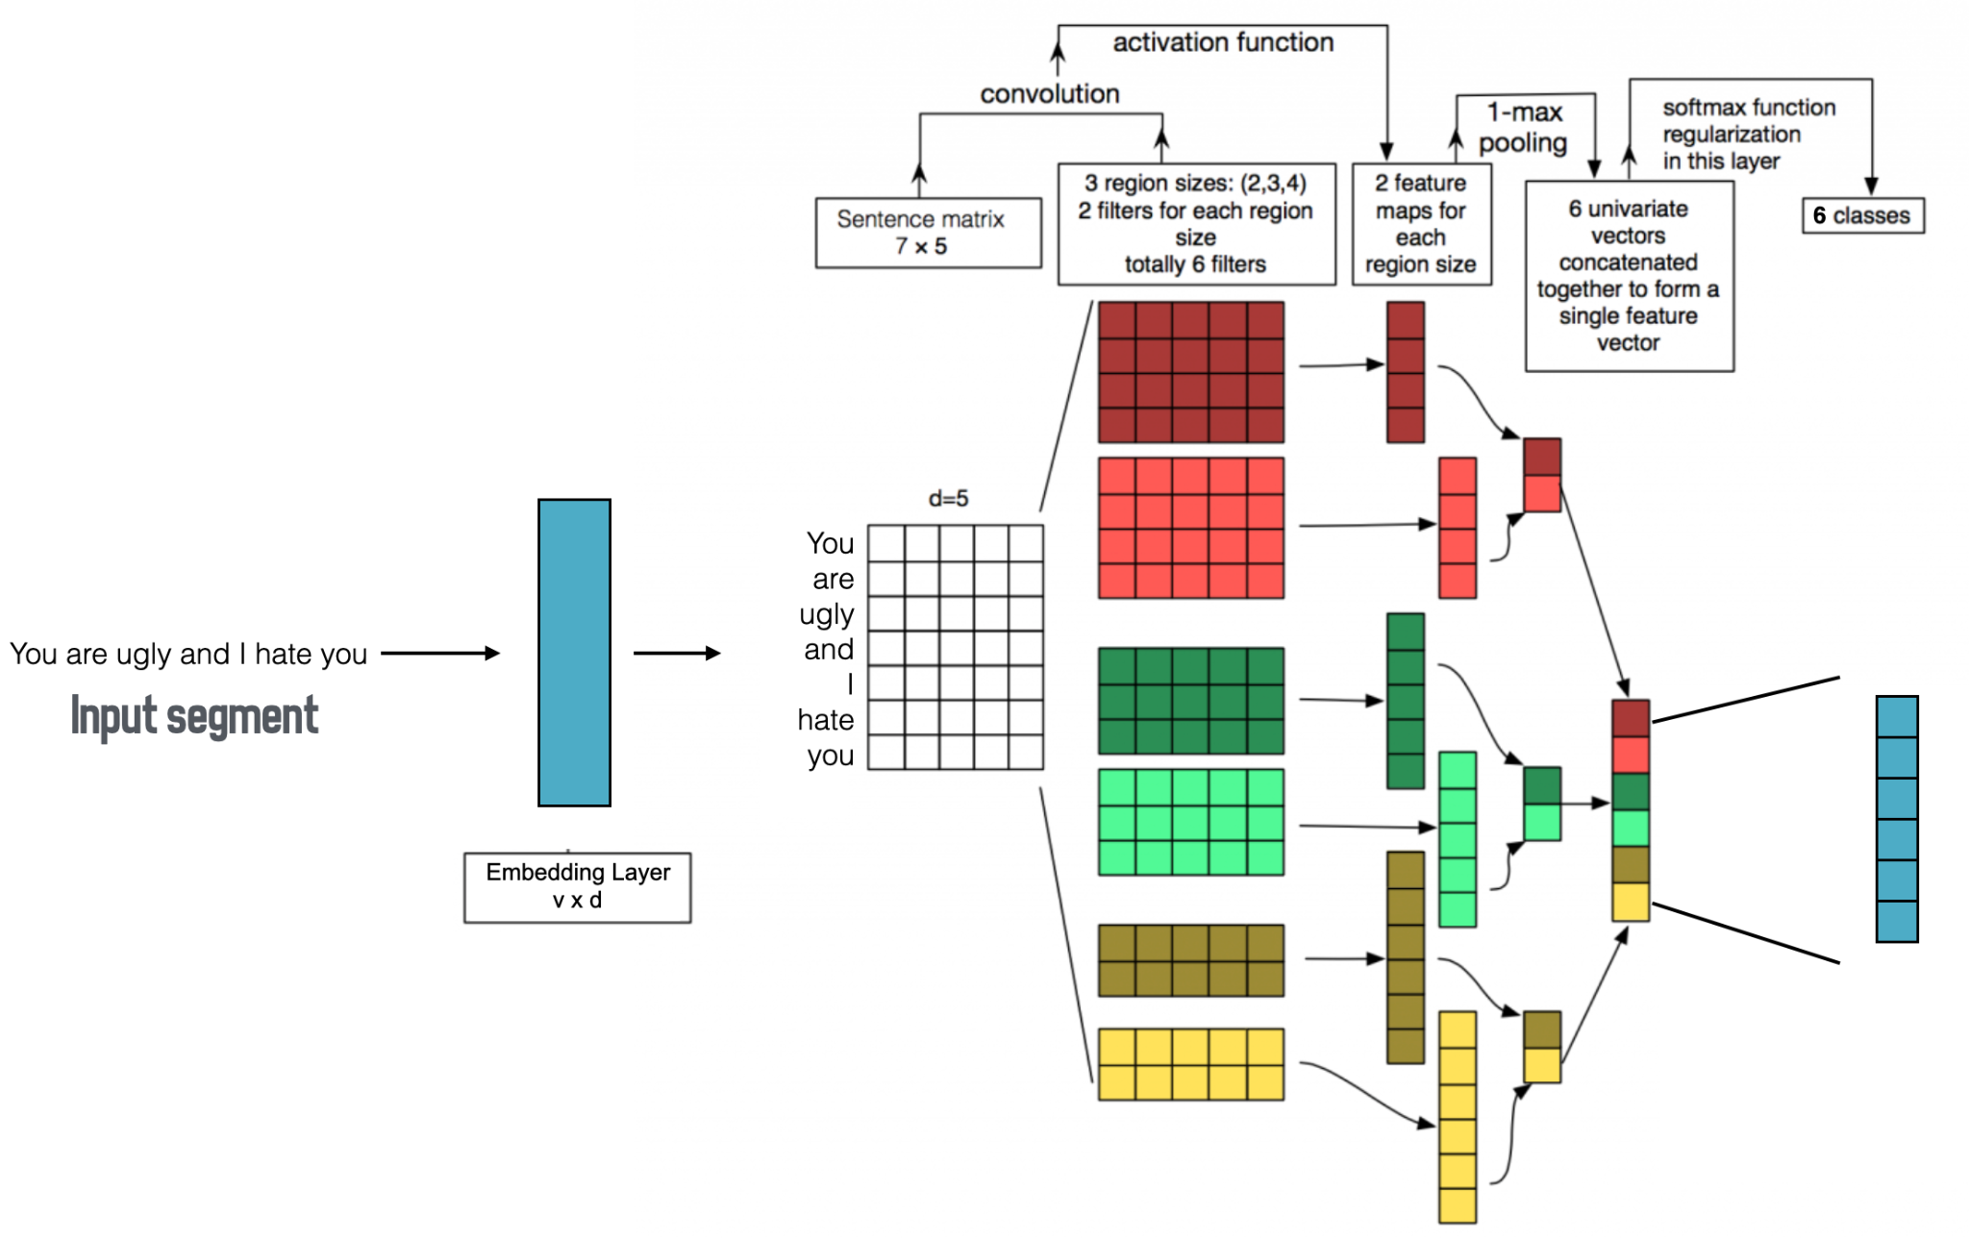
Working of Neural Network Model

Slide 19
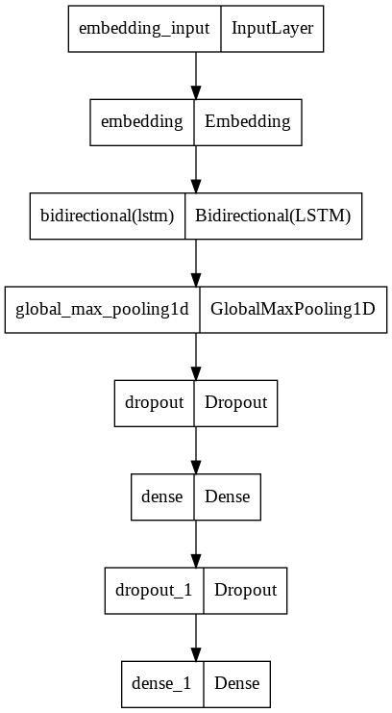
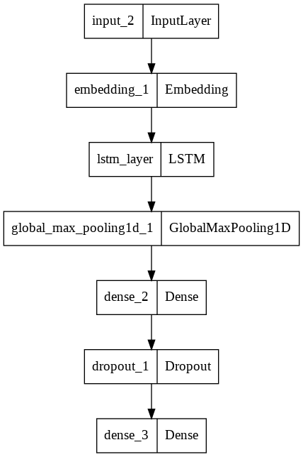
Fig. 1 Approach 1 Model Summary using Bidirectional LSTM
Fig. 2 Approach 2 Model Summary using LSTM

Slide 20
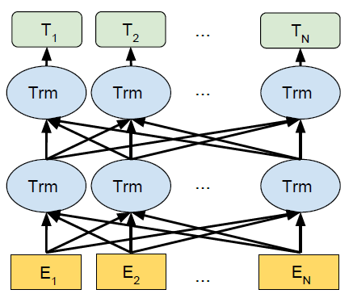
Bidirectional Encoder Representations from Transformers (BERT)
Three main benefits of BERT:
BERT is pre-trained on large amounts of data.
BERT is open source. We were able to import a BERT model from a built-in Python library.
The original BERT has two pre trained models: 1) BERT-base features 12 encoders with 12 bidirectional self-attention heads. 2) BERT-large features 24 encoders with 16 bidirectional self-attention heads.
BERT takes into account the context for each occurrence of a given word which makes BERT one of the best language models.

Slide 21
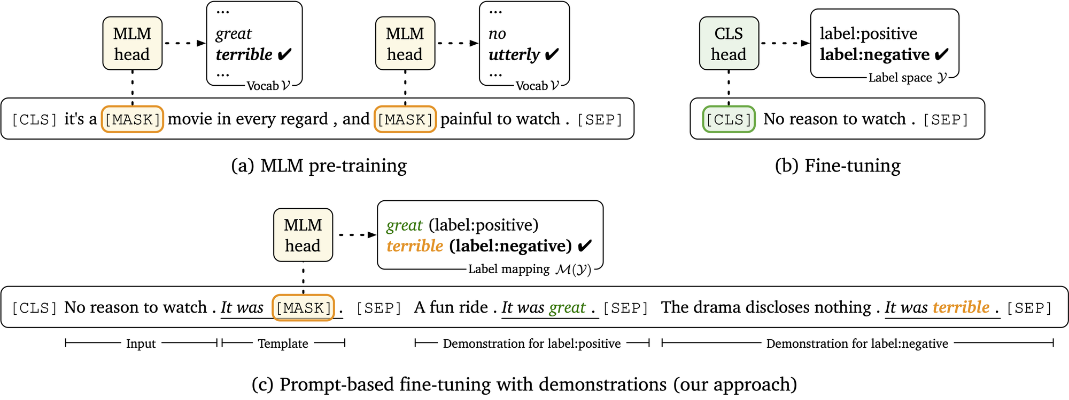
BERT Working
BERT works in two steps: 1. Pre-training: In the pre-training phase, it uses a large amount of unlabeled textual data to learn a language representation in an unsupervised fashion.
2. Fine-tuning: In Fine-tuning phase, we used learned weights from pre-trained models in a supervised fashion using a small number of labeled textual datasets.

Slide 22
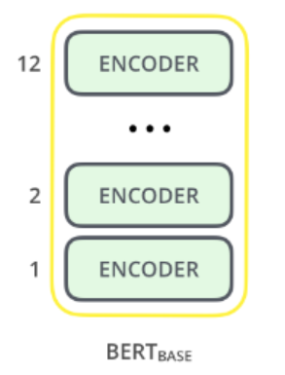
BERT Model Architecture
BERT comes in two sizes, BERT BASE and BERT LARGE. For our classification, we would be using BERT BASE model. Parameters of chosen BERT model are: 1. Encoder Layers : 12 2. Hidden Unit Size : 768 3. Self-Attention Heads : 12 4. Total Params : 110, 000, 000

Slide 23
BERT - Classification
The goal of classification is to utilise the learned weights of the BERT model, from the fine-tuned phase (which generates context based feature vectors for text data) in our model with minimal task-specific architecture adjustment. 1. This allows the training to be inexpensive relative to the pre-training phase. 2. Re-usability. For fine tuning the model, we use 1 dense layer with 3 classifier output units (Neurons). Optimiser ⇒ “Adam” Loss Function ⇒ “Categorical Cross Entropy” Accuracy Metric ⇒ “Categorical Accuracy” Activation Function ⇒ “SoftMax” Epochs ⇒ “04” Batch Size ⇒ “16”

Slide 24
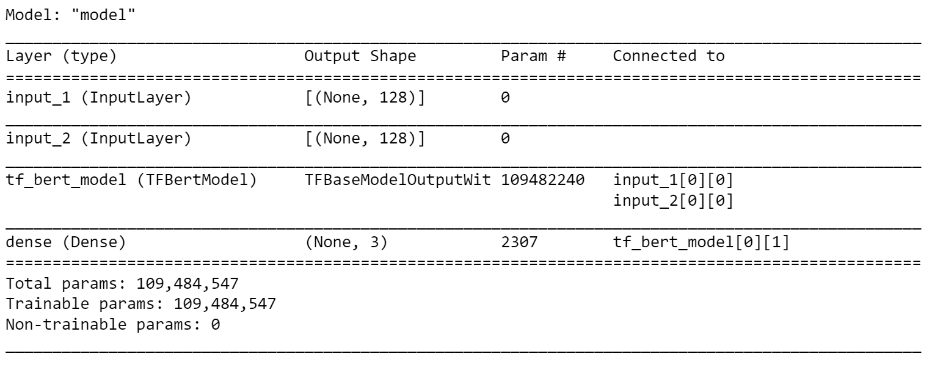
Model summary

Slide 25

Sentiment Prediction using Spacy
spaCy provides a concise API to access its methods and properties governed by trained machine (and deep) learning models.
We implemented pipeline approach to automate all the processes involved in model building, which in turn is created by loading the models.
There are different type of models provided in the package which contains the information about language – vocabularies, trained vectors, syntaxes and entities.
We explored Tokenization, POS tagging, Dependency Parsing, Noun phrases and Word to Vector integration in our model.
Next, we performed all the steps required to build the model and used our model to make predictions. For example, our model was able to classify a review as either Positive or Negative.

Slide 26
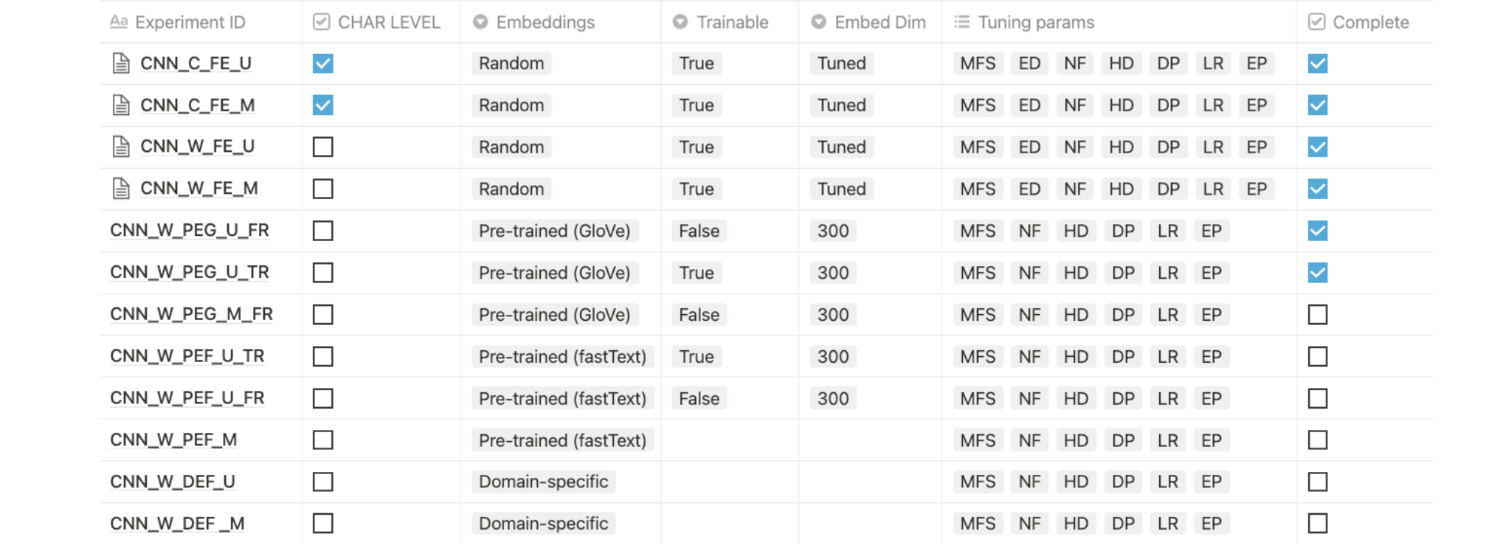
Ablation Study
An ablation study is when you eliminate sections of the input systematically to see which elements of the input are significant to the output.
In deep neural network model, we have removed layers in a rational manner and examined how this affects the network’s performance.
Importance:
Understanding causality in the system is the the goal of any research. An ablation is a low-effort approach to investigate causation.
If we take any sophisticated deep learning experimental configuration, there is a good possibility that we may delete a few modules without affecting performance.
Removing the noise from the research process by conducting ablation studies helped us achieve good results.

Slide 27
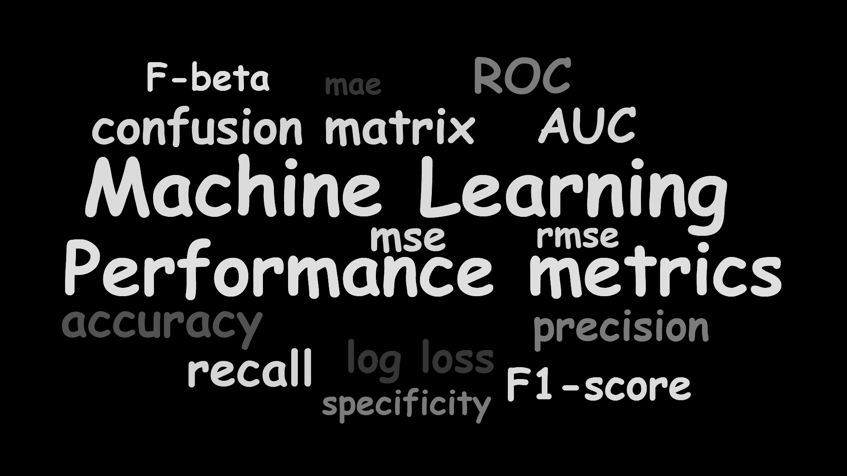
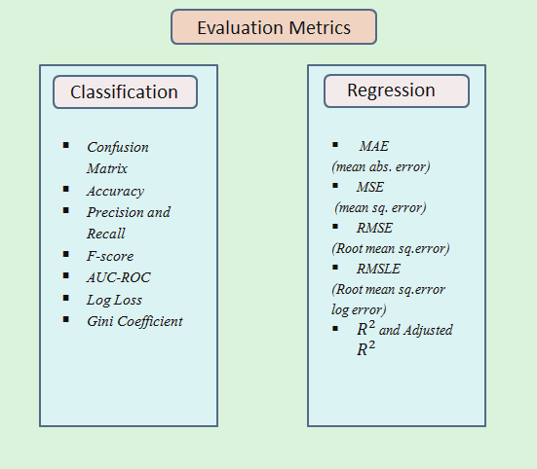
Evaluation
We primarily use the following metrics to evaluate our model’s performance
Accuracy : Fraction of the predictions our model correctly classified
Precision: Fraction of the relevant instances among the retrieved instances
Recall: Fraction of the relevant instances that were retrieved
F-1 Score: Harmonic mean of precision and recall
Confusion matrix

Slide 28
Machine Learning Performance
Model | Accuracy | Precision | Recall | F-1 Score
Naive Bayes | 0.79 | 0.80 | 0.74 | 0.76
Logistic Regression | 0.79 | 0.78 | 0.77 | 0.77
SVM | 0.77 | 0.76 | 0.76 | 0.76
Random Forest | 0.76 | 0.74 | 0.75 | 0.75
CatBoost | 0.81 | 0.81 | 0.80 | 0.81
MLP | 0.81 | 0.84 | 0.80 | 0.82

Slide 29
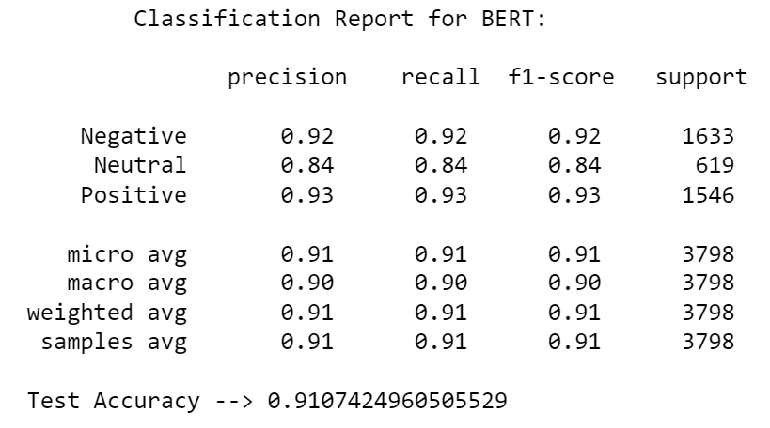
BERT Performance
Batch Count : 3046
Batch Size : 16
Final Loss : 0.1039
Epoch 1
loss : 0.4898 - categorical_accuracy : 0.8070
val_loss: 0.3272 - val_categorical_accuracy: 0.8853
Epoch 2
loss : 0.2336 - categorical_accuracy : 0.9185
val_loss: 0.2175 - val_categorical_accuracy: 0.9276
Epoch 3
loss : 0.1528 - categorical_accuracy : 0.9467
val_loss: 0.2517 - val_categorical_accuracy: 0.9274
Epoch 4
loss : 0.1039 - categorical_accuracy : 0.9648
val_loss: 0.2079 - val_categorical_accuracy: 0.9413

Slide 30
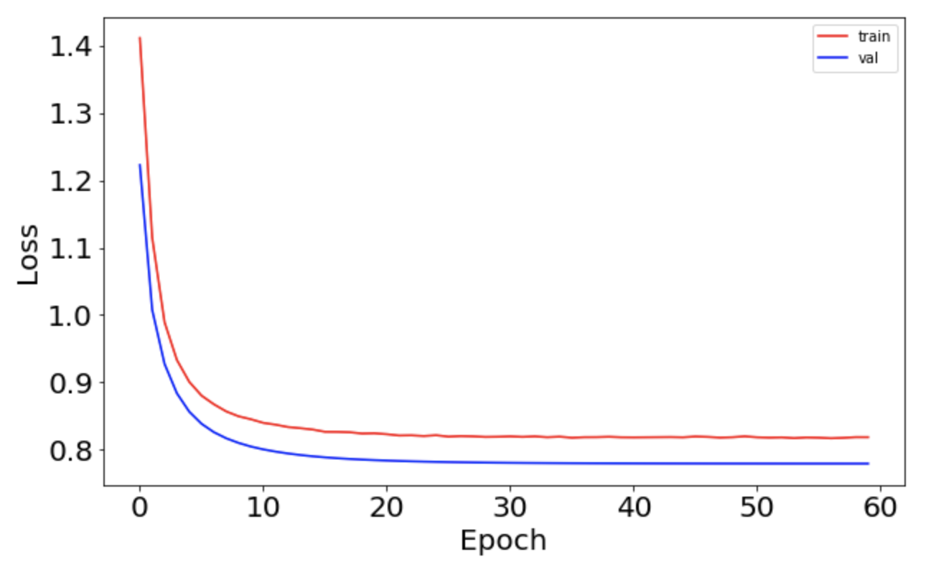
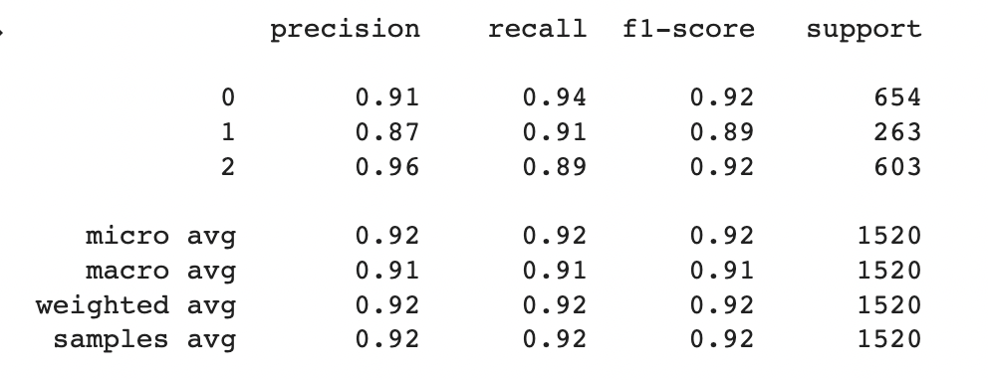
Neural Network Model Performance
Loss: 0.4124
Test Accuracy: 0.9171

Slide 31
Conclusion
This project adds to a growing corpus of research obtaining the best test accuracy of around 92% using Neural Network model (Bidirectional LSTM) amongst all the acquired research.
Explored the dataset using data analysis and plotting of different features using data visualization techniques
Presented the effectiveness of underlying machine learning models by classifying tweets based on sentiments and achieving good accuracy scores.
Proposed a BERT model using 12 encoder layers and obtained high test accuracy of 91%.
We explored textual data using spaCy library and built a text classification model which will predict the sentiment of the tweet provided by a user.
Vectorization of textual data in different ways is also explored using CountVectorizer, TfIdf Vectorizer and Word2Vec in this project.
Overall, a great cumulative experience for us taking the theory we learn in class and using it as a real world application.

Slide 32
Future Scope
Forced to use batch size 16 using BERT due to memory constraints. Regardless, future research should continue to explore different parameters.
Using enhanced models which might improve the model performance, (e.g., RoBERTa, XLNet, Transformers).
Increase performance of Neural Network models and BERT through further modification of the hyperparameters.
Future studies could dive deeper into feature engineering using Spelling corrector, Sentiment scores and n-grams.
Looking forward, working on advanced models and advanced Ensemble models such as (e.g., stacking, boosting) might prove beneficial.
A number of recommendations for future research are provided which would help future researchers to investigate the problem.

Slide 33
References
Sentiment analysis: Predicting sentiment of covid-19 tweets. Analytics Vidhya. (2021, February 22). Retrieved March 8, 2022,https://www.analyticsvidhya.com/blog/2021/02/sentiment-analysis-predicting-sentiment-of-covid-19-tweets
Jalil, Z. (2022). COVID-19 Related Sentiment Analysis Using State-of-the-Art Machine Learning and Deep Learning Techniques. Frontiers. https://www.frontiersin.org/articles/10.3389/fpubh.2021.812735/full
Coronavirus tweets NLP - Text Classification. (2020, September 8). Kaggle. https://www.kaggle.com/datatattle/covid-19-nlp-text-classification?select=Corona_NLP_train.csv
R. (2022, February 4). Covid-19 Text Classification Using BERT (TPU). Kaggle. https://www.kaggle.com/ravikumarmn/covid-19-text-classification-using-bert-tpu/data
Ludovico Cuoghi. (2021, December 22). Twitter sentiment analysis with Bert + Roberta . Kaggle. https://www.kaggle.com/code/ludovicocuoghi/twitter-sentiment-analysis-with-bert-roberta

